Slide 1
1 Planed
Planed 1
Study Plan (qq.com) Finsih the first plan
Finsh the project3
Study markdown and how to use git
4

Slide 2
1 Results
Results 1
Have learned the first three blog .
I planed to learn to use git after finishing the project3 , but I am still studying to write the shellCodeGenerator.
4

Slide 3
1 Challenges and Solutions
Challenges and solutions 1
While code is compiling, the constants declared in code will be loaded into the constant area , right? So why I can’t use the constants?
The main reason is for code portability , right?
4

Slide 4
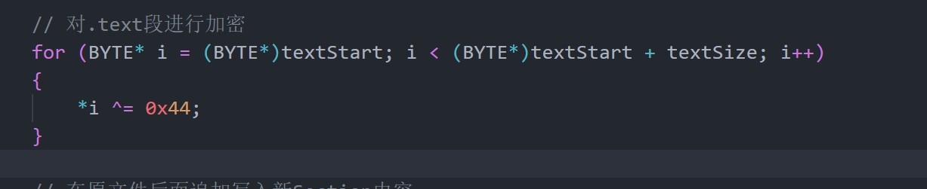
2 Challenges and Solutions
Challenges and solutions 2
The .text contains source code before inserting shellcode , why the write encrypt this piece of code?
4

Slide 5
3 Challenges and Solutions
Challenges and solutions 3
Just a little condusion , the calculation of RVA is to alignment memory , but why the operation ‘&’ is used? Can I just write “size_t RVA = pSecHeader[secCount - 1].VirtualAddress + 0x1000;” ?
4

Slide 6
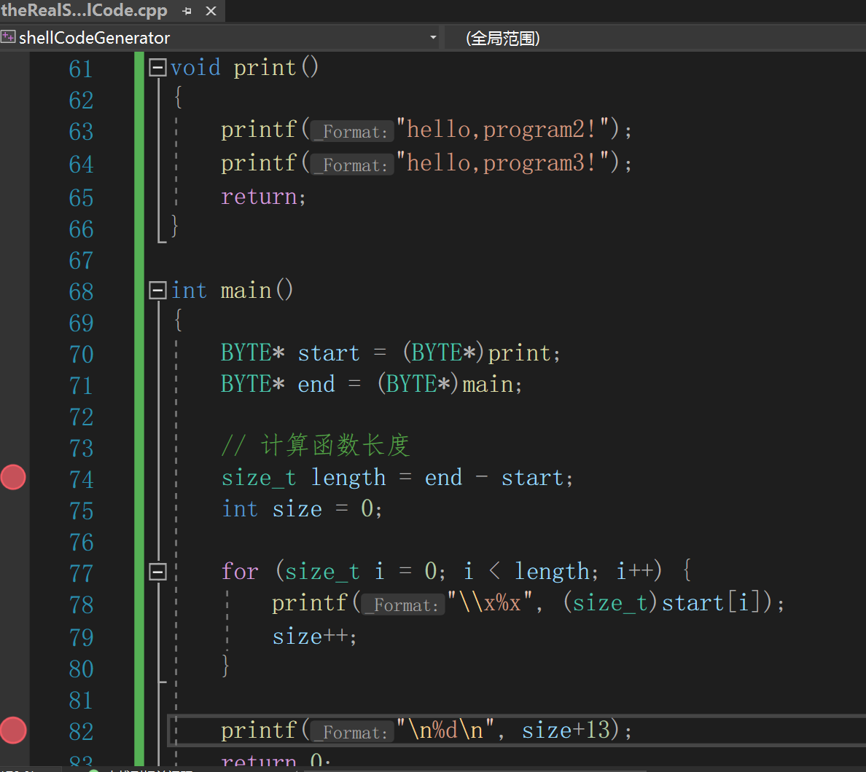
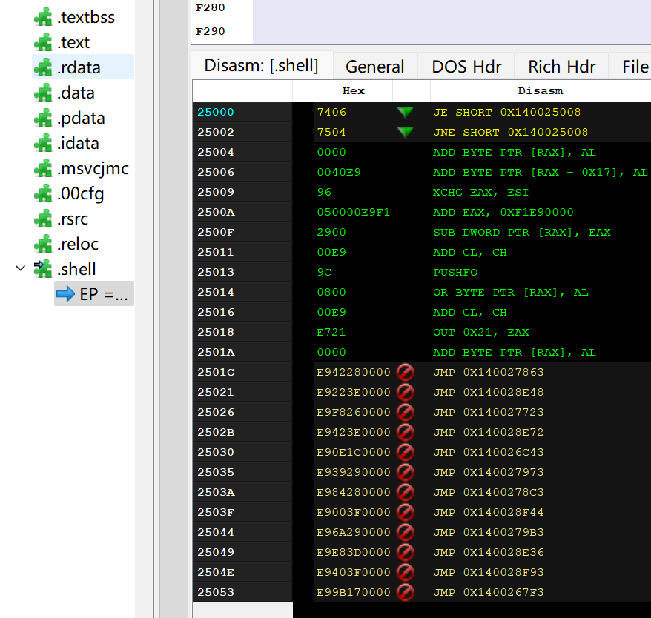
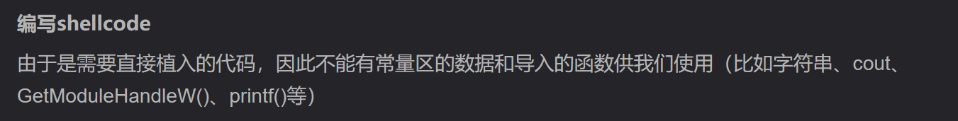
4 Challenges and Solutions
Challenges and solutions 4
It is difficult for me to describe the question so I will explain this question in Chinese.
我当时想测试一下能不能直接把print这个函数变成二进制代码直接插入到我新增的.shell节点中，可以插入，但是后面有一部分变成汇编语言后jmp到了无法访问的地方，于是这个加壳后的程序最终无法运行。我猜测是这里的printf函数需要调用的函数库的位置问题。
【Windows】从零开始写一个加密壳_编写一个简单的加密壳_古月浪子的博客-CSDN博客
在上面那篇博客中，它说是不能有常量区的数据和导入数据的函数供我们使用，为什么？那么这样的话壳的作用不久变小了吗？或者说可以自己写一个函数库再往原程序后面加上一个节点放这个函数库，要用函数的时候jmp过去就行了？
4

Slide 7
1 Plan
plan 1
I plan to be clear about how to write shellcode , so I want to not only read these blogs but also finish some shellcode by meself step by step after finishing project3.
I decide to give myself another week for shellcode study.
4

